Slide 1
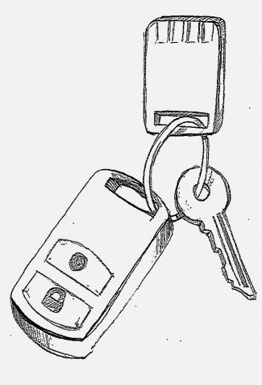
U2F - Universal 2nd Factor
Google U2F (Gnubby) Documents - Snapshot prior to joining FIDO
Web Keychain Device for users
open standard strong authentication
for the web

Slide 2
What we'll cover
U2F Overview
Problem being solved
Value to the end user
Value to the Service Provider (RP)
Value to the device vendor, integration vendor
How U2F works
Protocol design considerations
Integration into browser
More use cases
Current Status
The larger view: FIDO Alliance
Device Centric Auth
FIDO offerings as a complementary whole
Google U2F (formerly Gnubby) - pre-FIDO

Slide 3
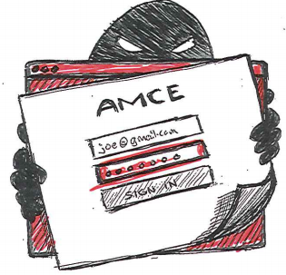
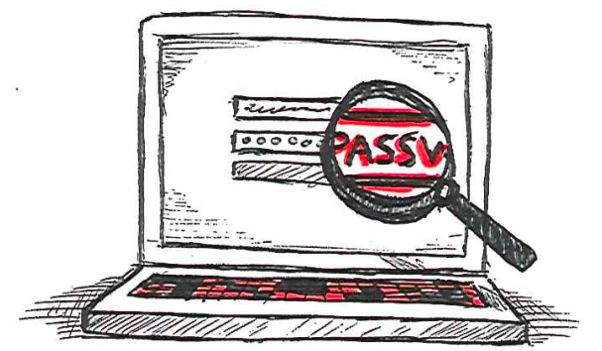
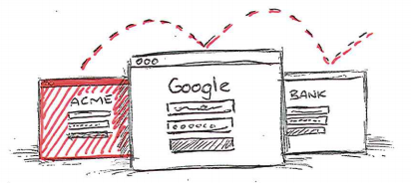
Web passwords are broken
REUSED
PHISHED
KEYLOGGED
Google U2F (formerly Gnubby) - pre-FIDO

Slide 4
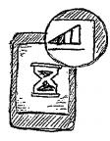
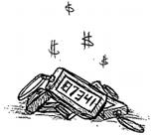
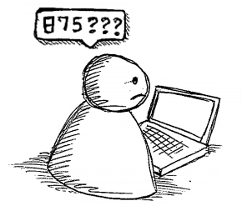
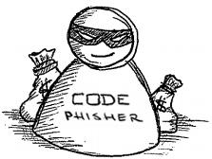
Today's solution: One time codes: SMS or Device
SMS USABILITY
DEVICE USABILITY
Coverage Issues - Delay - User Cost
One Per Site - Expensive - Fragile
USER EXPERIENCE
PHISHABLE
Users find it hard
German Police re: iTan: ".. we still lose money"
Google U2F (formerly Gnubby) - pre-FIDO
Notes:
SMS usability <graphic>
Coverage issues
Delay
User costs
Device usability <graphic> (maybe this and this)
One per site!!
Expensive
Fragile
More Fundamental Issues
Users find it hard <puzzled user graphic?>
Phishable; Already exploited; <bad guy graphic?>
German Police Re: iTan: "Doesn't work, we still lose money"

Slide 5
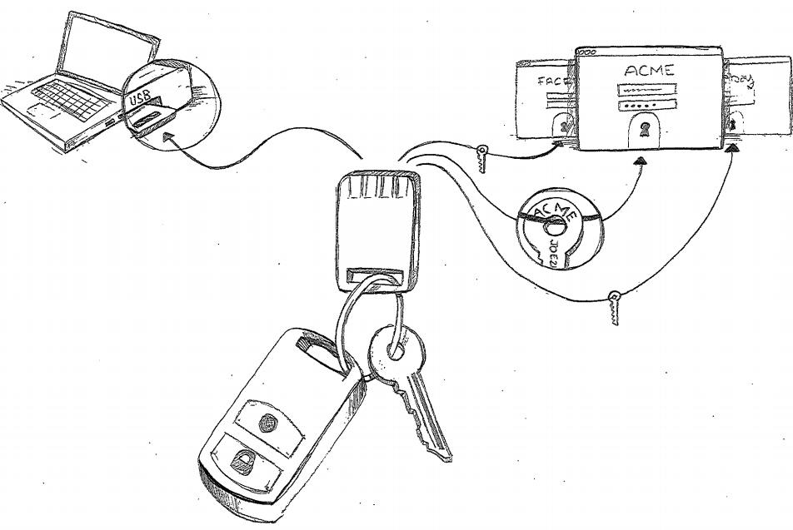
The U2F solution: How it works
One device, many services
Easy: Insert and press button
Safe: Un-phishable Security
Google U2F (formerly Gnubby) - pre-FIDO

Slide 6
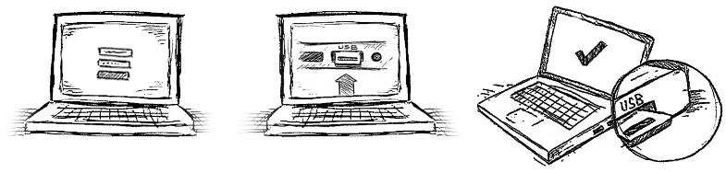
Simple for Users
1
2
3
Userid & Password
Insert, Press button
Successful Sign in
Google U2F (formerly Gnubby) - pre-FIDO
Notes:
Flow graphic "Novice user":
Goes to acme.com with login and password and hits ok.
Gets intermediate "Please insert your token" screen
User inserts device, presses button and presses ok
Sees "successful login screen"
User removes device and puts back in pocket
Flow graphic "Power User (Novice after a few logins)"
1. Goes to acme.com with login and password (doesnt hit ok)
2. Inserts device and presses button.
3. Hits ok and see logged in Screen.
(If necessary button pressing on device can be skipped as a detail in the graphic) (this can be broken into two slides as necessary)

Slide 7
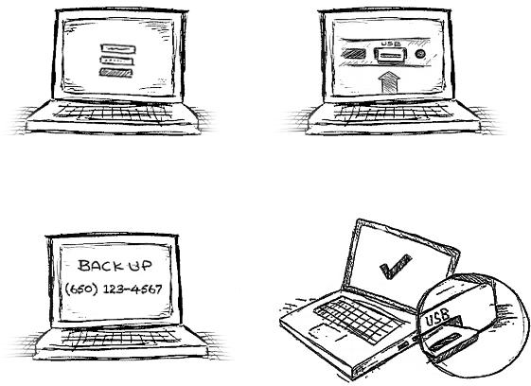
User self-registration
1
Userid & Password
2
Insert, Press Button
3
Backup Options
4
Registration Done
Google U2F (formerly Gnubby) - pre-FIDO
Notes:
Phishing and ITAN: http://techie-buzz.com/tech-news/german-court-rules-against-client-phishing.html
Flow Graphic: User sees marketing material with
Goes to acme.com/register
Logs in with user name and password
(Optional) Site asks for additional verification -- Last 4 of SSN?
"Please insert device" screen.
User inserts device and presses button
"Thank you for registering" screen
User removes device and puts in pocket (some way to suggest he/she carries device with him/her)

Slide 8
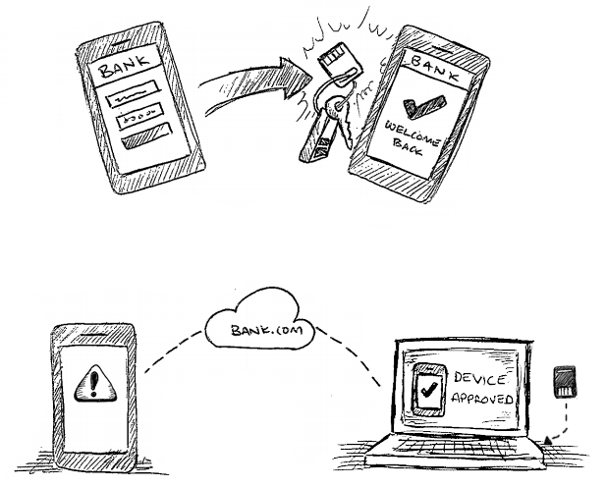
Usage on Mobiles
Tomorrow
Tap your NFC-aware device to your NFC-enabled phone
(modulo, choosing the right app isolation tradeoff ... )
Today
Use your computer to bless your mobile (one time action)
Google U2F (formerly Gnubby) - pre-FIDO
Notes:
With NFC: Tap the phone with device
Graphic1: App with login page opened and filled being tapped on U2F on a key chain.
Graphic2: User logged in
Sidebar: User tapping phone to pocket (device in pocket)
Sidebar2: User tapping keychain to laptop with NFC
Without NFC: Bless the phone with device
Graphic1: User at login page of device
Graphic2: Intermediate screen saying "Please login to a computer and insert device"
Graphic3: User logs into computer with device inserted.
Graphic4: Phone says "This phone has been registered. Please login with user name and password in future".
Note: Mobile registration can happen with initial registration

Slide 9
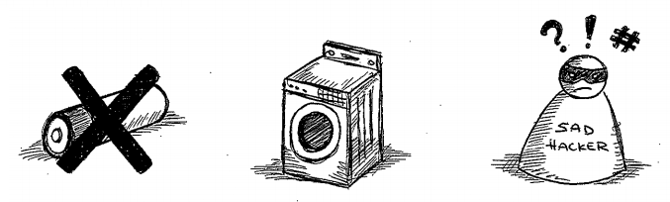
Like a real key: Small, Reliable, Secure
No Batteries
Vigorously Tested
Secure Element Guarantees
Google U2F (formerly Gnubby) - pre-FIDO
Notes:
Graphics:
No Batteries (batteries with a cross through them?).
Washed in washing machine.
Can't be hacked: Malware with cross through it?
Not needed:
Run over by a car.
Eaten by a dog.

Slide 10
U2F Protocol
Core idea: Standard public key cryptography:
User's device mints new key pair, gives public key to server
Server asks user's device to sign data to verify the user.
One device, many services, "bring your own device" enabled
Lots of refinement for this to be consumer facing:
Privacy: Site Specific Keys, No unique ID per device
Security: No phishing, man-in-the-middles
Trust: Verify who made the device
Pragmatics: Affordable today, ride hardware cost curve down
Speed for user: Fast crypto in device (Elliptic Curve)
Feature Growth: Server<->device encrypted comm.; future trusted display
Think "Smartcard re-designed for modern consumer web"
Google U2F (formerly Gnubby) - pre-FIDO

Slide 11
Under the hood
Device core: Secure element accessed over USB or NFC
Driverless USB on Win, Mac, Linux, Chrome OS
Just plug in and use
Direct Access from Browser:
No client middleware to install
Simple Javascript API: 'Create Key Pair' and 'Sign'
Not just tied to login! Use anytime you want to strongly verify user.
Same API on Android
Just integrate with your app
UI seen by user completely under server control
Server side integrates easily with existing auth services
Google U2F (formerly Gnubby) - pre-FIDO

Slide 12
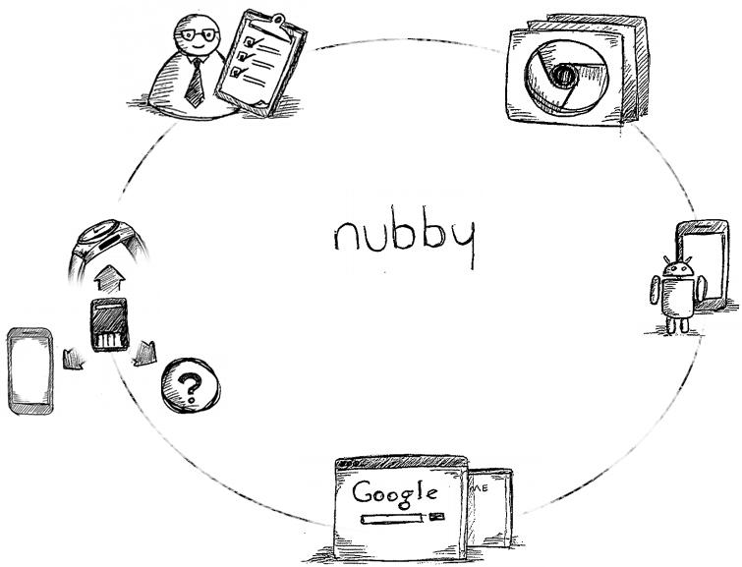
Open Ecosystem: Virtuous Cycle
CONSULTING
BROWSER SUPPORT
OPEN joining
FIDO ALLIANCE
creating U2F WORKING GROUP
MOBILE SUPPORT
MANY DEVICES & FORM FACTORS
ADOPTION
Google U2F (formerly Gnubby) - pre-FIDO
Notes:
Vision: Open Industry Consortium
Open Industry Consortium < center of circle in graphic>
Virtuous cycle in graphic
Supported by major browsers and mobile OSes
Utilized by destinations that matter
Many device vendors and form factors
in credit card, on mobile, on bracelet, on watch (graphics), Mobile device covers
Ecosystem of server vendors, consulting

Slide 13
U2F - Universal Second Factor: In a nutshell
User carries a strong auth. device, works across services:
Small USB/NFC dongle with secure element
Works out of box, no software install
Mental model "Like a key on your chain, a card in your wallet"
For the user: Easy Secure Login
One device, Many services
Simple UX - Insert and press button or tap, no software install
Passwords can be made simple -- 4 digit pins like ATM?
Very rugged and reliable, like a real physical key
For the web site: Open Strong Security
Open: Not proprietary, multiple vendors, no central service required
Self provisioned: No pre-seeding req, "Bring your own token" possible
Strong Security: Non-Phishable, Blocks most practical MITMs
Strong Privacy: One site cannot use credential given to another
Google U2F (formerly Gnubby) - pre-FIDO

Slide 14
Other usage models beyond "One key you carry"
Token plugged permanently into home machine
husband and wife share
husband for paypal and google, wife for schwab and amazon
One token plugged into home, one token plugged into work
User provisions both for paypal, can pay from either place
One token plugged into home, one token to carry
Convenience, home computer always ready to go
One (tiny) token plugged permanently into work laptop
Laptop becomes the 2nd factor (maybe built into next-gen laptops?)
Husband/wife, separate tokens, plugged in simulatenously
Each activates own key, protocol has no problem with multiple keys
One account, multiple users, each with own token
Small business users share an account with strong auth
Account lockdown to a single device
Only one token, plugged into office machine
Same token for work account and personal account
Work (= enterprise) leverages user's "bring your own token"
Different token for work account and personal account
If enterprise doesn't like self-provision, so ships pre-provisioned token
Google U2F (formerly Gnubby) - pre-FIDO

Slide 15
Current Status
Google "intranet" single sign on is U2F enabled
Our "intranet" is directly on the web, so its just web login
Using a Chrome Extension, step towards browser integration
Not using final JS API
Integration at "lower" level, but its just eng execution
Many thousand devices in daily use
Compliant devices by Yubico, built around NXP "U2F" secure element.
Various software milestones since October
Now moving into rapid scaling of Beta
Intend to fully replace OTP for employees by end of year
Will be ~100,000 units in deployment
Solving use cases for non-web "legacy" clients
Eg, VPN client via Browser extension
We are rolling our own, but fertile ground for ISVs for commercial use
Glad to help interested RPs to a proof of concept
You implement server side with FIDO specs, code fragments
Compliant token devices already available
Get experience on how the end to end experience works
Google U2F (formerly Gnubby) - pre-FIDO

Slide 16
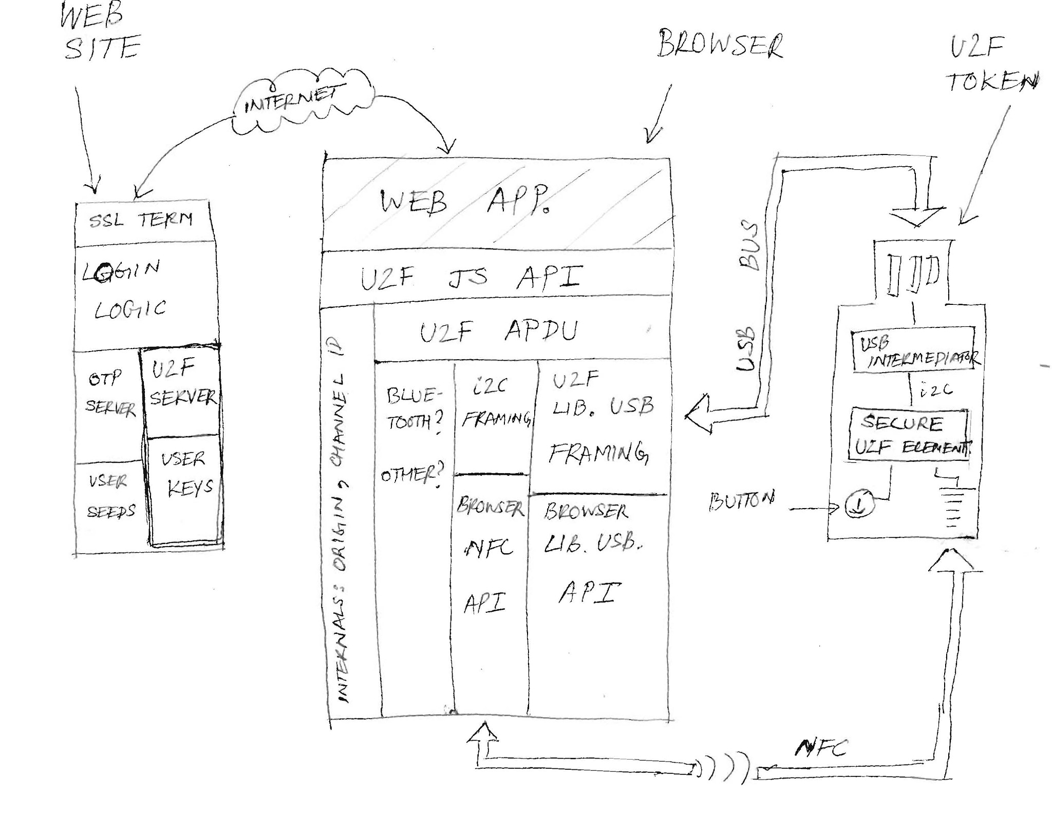
U2F Schematic
Google U2F (formerly Gnubby) - pre-FIDO

Slide 17
Next Section: Larger View: FIDO Alliance
Google U2F (formerly Gnubby) - pre-FIDO

Slide 18
The Larger View as Google sees it
Core need for web service: Ask user for permission
"You are logging in to create a new session. Please approve"
"You are deleting all your email. Please approve"
"You are transferring $100,000 to Sam. Please approve"
"You are shipping your purchase to a new address. Please approve"
Done today with passwords today and maybe OTPs
Difficult for user, insecure (phishable, MITM, not malware resistant)
Megatrend: Users moving to varied personal devices
User devices have user-specific local authentication (screen lock etc)
PINs today, biometric on horizon -- many different kinds of local auth.
Opportunity: Easy and Secure Web authentication
Web service asks user for permission
To approve, user does user-specific local auth on their device
Web service gets some crypto proof of permission.
Passwords no longer required for routine authentication
Google U2F (formerly Gnubby) - pre-FIDO

Slide 19
A Solution Framework
User's device has keystore unlocked by user's local auth
Each user of device has own keystore space
Devices will have different kinds of local auth (PIN, Various biometrics)
User registers device to web service
Creates a web service specific key pair
Key creation enabled by local auth
Hands public key to web service
Web service verifies user permission by
Asking for signature matching public key
User does local auth, unlocks keystore, signs with private key
In gist: User does simple auth gesture on personal device to easily and securely approve a website's request
Very aligned with FIDO alliance's current efforts
So why not just join them and take U2F under the FIDO banner?
However, important to retain immediacy and simplicity of U2F
Google U2F (formerly Gnubby) - pre-FIDO

Slide 20
How the parts of FIDO fit after Google joins
Existing FIDO efforts (technical working group)
Larger View, password less, local device auth for sign
U2F = Universal 2nd Factor
Critical bridge to future, "classic" 2-factor, incremental change for RP
Service (RP) password still present, but can be simple (4 digit PIN?)
Fit together as one whole for Service Provider (RP)
At registration time: Discover user has FIDO passwordless enabled device? Register for passwordless experience Else offer user FIDO U2F: Self-register for simple password + 2 factor experience
At login time: User has FIDO passwordless enabled device + enrollment? Give user passwordless "just unlock gesture" experience Else user has U2F enrollment? Give user simple pwd + "show a 2 factor device" experience
Some RPs may want only passwordless, some only U2F
That's no problem: FIDO is all about the right choice for RP and user
Note that RP can start offering "other" flavor later seamlessly.
Same server can talk both passwordless and U2F protocols (closely related)
Google U2F (formerly Gnubby) - pre-FIDO

